Slide 1
Software Testing

Slide 2
Testing
The aim of testing is to identify all defects in a software product.
However, in practice even after thorough testing:
  one cannot guarantee that the software is error-free.

Slide 3
Testing
The input data domain of most software products is very large:
  it is not practical to test the software exhaustively with each input data value.

Slide 4
Testing
Testing does however expose many errors:
  testing provides a practical way of reducing defects in a system
  increases the users' confidence in a developed system.

Slide 5
Testing
Testing is an important development phase:
  requires the maximum effort among all development phases.
In a typical development organization:
  maximum number of software engineers can be found to be engaged in testing activities.

Slide 6
Testing
Many engineers have the wrong impression:
  testing is a secondary activity
  it is intellectually not as stimulating as the other development activities, etc.

Slide 7
Testing
Testing a software product is in fact:
  as much challenging as initial development activities such as specification, design, and coding.
Also, testing involves a lot of creative thinking.

Slide 8
How do you test a system?
Input test data to the system.
Observe the output:
  Check if the system behaved as expected.

Slide 9


How do you test a system?
Input
System
Output

Slide 10
How do you test a system?
If the program does not behave as expected:
  note the conditions under which it failed.
  later debug and correct.

Slide 11
Basic Concepts and terminologies
Error is a mistake committed by the developer team during any of the development phases.
An error is sometimes referred to as a fault, a bug or a defect.
Error, Faults, and Failures

Slide 12
Errors and Failures
A failure is a manifestation of an error (aka defect or bug).
  presence of an error may not lead to a failure.

Slide 13
Test cases and Test suite
Test a software using a set of carefully designed test cases:
  the set of all test cases is called the test suite

Slide 14
Test cases and Test suite
A test case is a triplet [I,S,O]:
  I is the data to be input to the system,
  S is the state of the system at which the data is input,
  O is the expected output from the system.

Slide 15
Verification versus Validation
Verification is the process of determining:
  whether output of one phase of development conforms to its previous phase.
Validation is the process of determining
  whether a fully developed system conforms to its SRS document.

Slide 16
Verification versus Validation
Aim of Verification:
  phase containment of errors
Aim of validation:
  final product is error free.

Slide 17
Verification versus Validation
Verification:
  are we doing right?
Validation:
  have we done right?

Slide 18
Design of Test Cases
Exhaustive testing of any system is impractical:
  input data domain is extremely large.
Design an optimal test suite:
  of reasonable size
  to uncover as many errors as possible.

Slide 19
Design of Test Cases
If test cases are selected randomly:
  many test cases do not contribute to the significance of the test suite,
  do not detect errors not already detected by other test cases in the suite.
The number of test cases in a randomly selected test suite:
  not an indication of the effectiveness of the testing.

Slide 20
Design of Test Cases
Testing a system using a large number of randomly selected test cases:
  does not mean that many errors in the system will be uncovered.
Consider an example:
  finding the maximum of two integers x and y.

Slide 21
Design of Test Cases
If (x>y) max = x;
else max = y;
The code has a simple error:
test suite {(x=3,y=2);(x=2,y=3)} can detect the error,
a larger test suite {(x=3,y=2);(x=4,y=3); (x=5,y=1)} does not detect the error.

Slide 22
Design of Test Cases
Systematic approaches are required to design an optimal test suite:
  each test case in the suite should detect different errors.

Slide 23
Design of Test Cases
Two main approaches to design test cases:
  Black-box approach
  White-box (or glass-box) approach

Slide 24
Black-box Testing
Test cases are designed using only functional specification of the software:
  without any knowledge of the internal structure of the software.
For this reason, black-box testing is also known as functional testing.

Slide 25
White-box Testing
Designing white-box test cases:
  requires knowledge about the internal structure of software.
  white-box testing is also called structural testing.

Slide 26
Black-box Testing
Two main approaches to design black box test cases:
  Equivalence class partitioning
  Boundary value analysis

Slide 27
Equivalence Class Partitioning
Input values to a program are partitioned into equivalence classes.
Partitioning is done such that:
  program behaves in similar ways to every input value belonging to an equivalence class.

Slide 28
Why define equivalence classes?
Test the code with just one representative value from each equivalence class:
  as good as testing using any other values from the equivalence classes.

Slide 29
Equivalence Class Partitioning
How do you determine the equivalence classes?
  examine the input data.
  few general guidelines for determining the equivalence classes can be given

Slide 30
Equivalence Class Partitioning
If the input data to the program is specified by a range of values:
  e.g. numbers between 1 to 5000.
  one valid and two invalid equivalence classes are defined.
1
5000

Slide 31
Equivalence Class Partitioning
If input is an enumerated set of values:
  e.g. {a,b,c}
  one equivalence class for valid input values
  another equivalence class for invalid input values should be defined.

Slide 32
Example
A program reads an input value in the range of 1 and 5000:
  computes the square root of the input number
SQRT

Slide 33
Example (cont.)
There are three equivalence classes:
  the set of negative integers,
  set of integers in the range of 1 and 5000,
  integers larger than 5000.
1
5000

Slide 34
Example (cont.)
The test suite must include:
  representatives from each of the three equivalence classes:
  a possible test suite can be:
  {-5,500,6000}.
5000
1

Slide 35
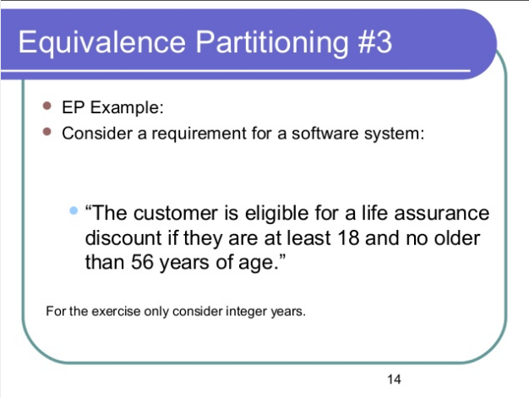


Slide 36
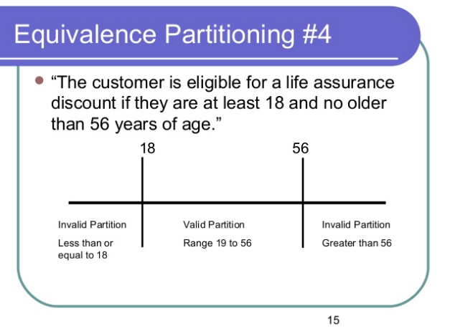

Slide 37
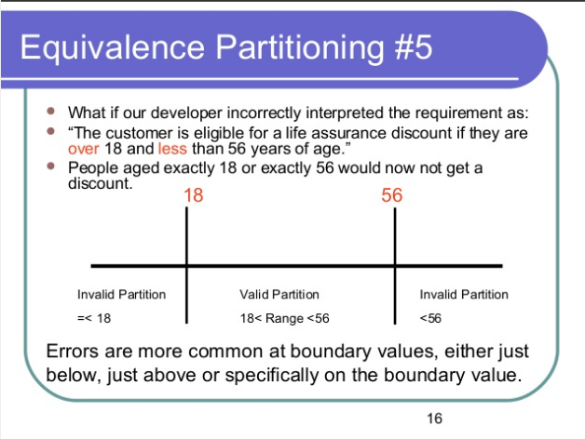

Slide 38
Boundary Value Analysis
Some typical programming errors occur:
  at boundaries of equivalence classes
  might be purely due to psychological factors.
Programmers often fail to see:
  special processing required at the boundaries of equivalence classes.

Slide 39
Boundary Value Analysis
Programmers may improperly use < instead of <=
Boundary value analysis:
  select test cases at the boundaries of different equivalence classes.

Slide 40
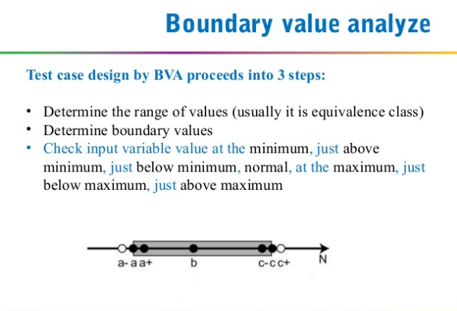

Slide 41
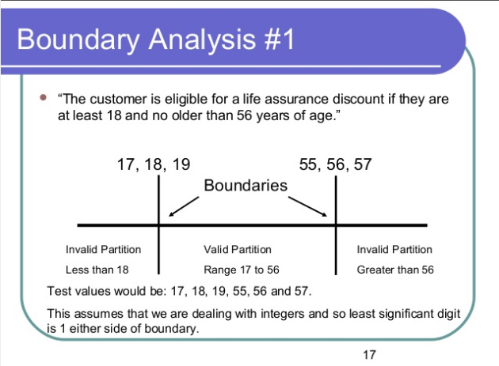

Slide 42
Example
For a function that computes the square root of an integer in the range of 1 and 5000:
  test cases must include the values: {0,1,5000,5001}.
1
5000

Slide 43
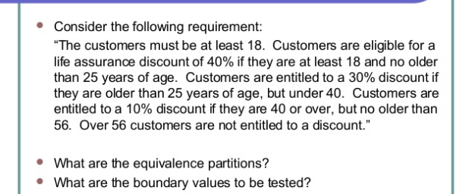

Slide 44
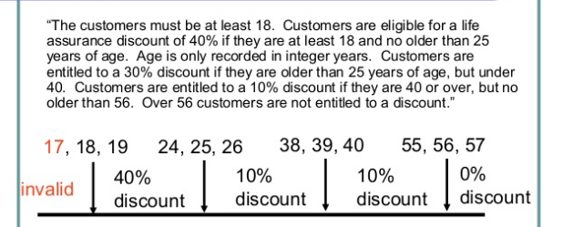

Slide 45
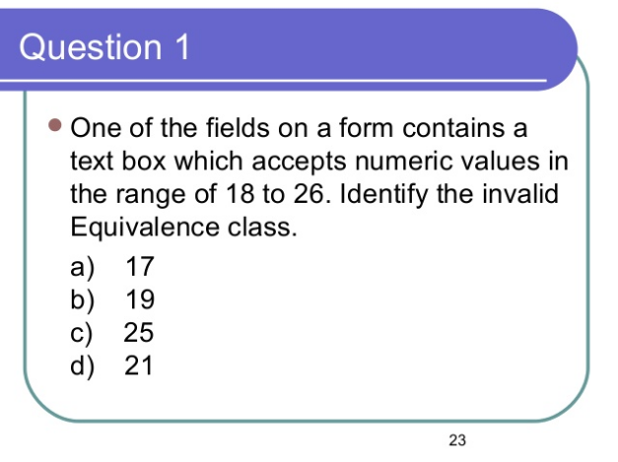

Slide 46
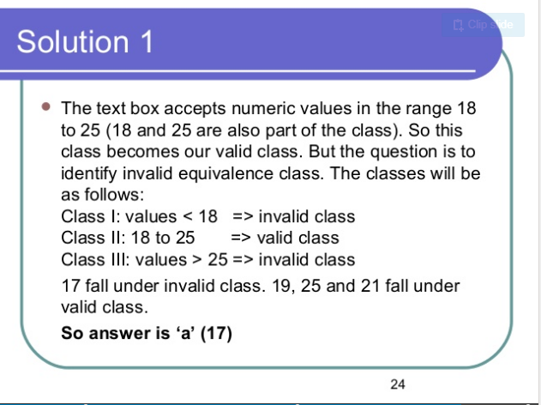

Slide 47
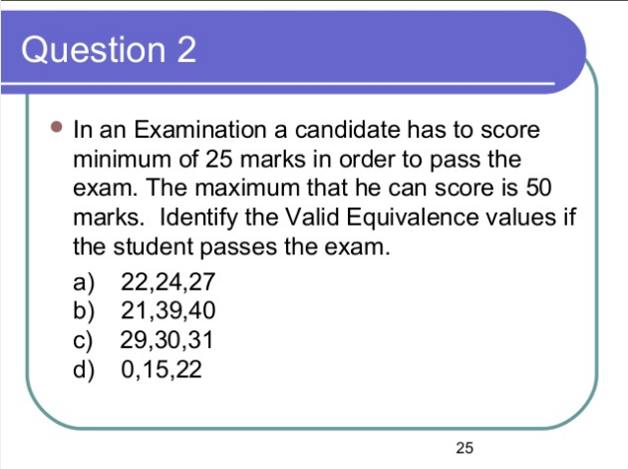

Slide 48
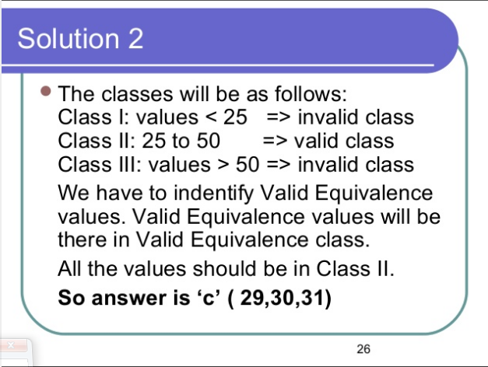

Slide 49
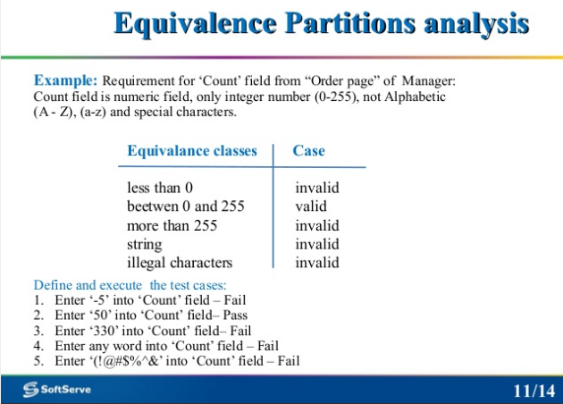

Slide 50
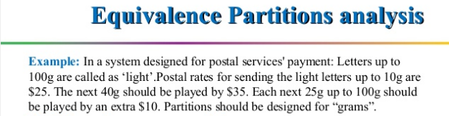
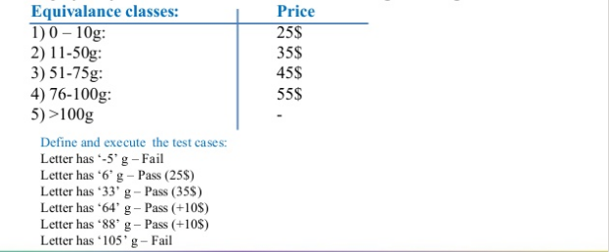

Slide 51
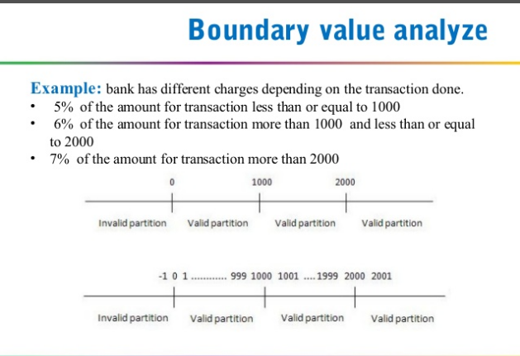

Slide 52
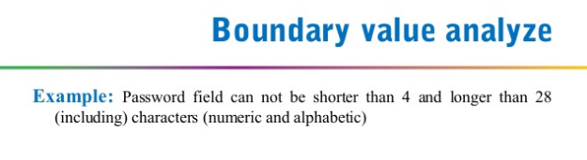

Slide 53
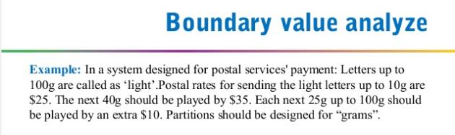
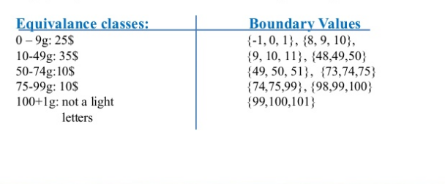

Slide 54
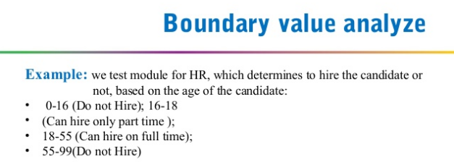
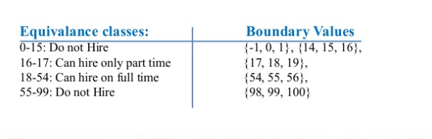

Slide 55
Levels of Testing
Software products are tested at three levels:
  Unit testing
  Integration testing
  System testing

Slide 56
Unit testing
During unit testing, modules are tested in isolation:
  If all modules were to be tested together:
    it may not be easy to determine which module has the error.

Slide 57
Unit testing
Unit testing reduces debugging effort several folds.
  Programmers carry out unit testing immediately after they complete the coding of a module.

Slide 58
Integration testing
After different modules of a system have been coded and unit tested:
  modules are integrated in steps according to an integration plan
  partially integrated system is tested at each integration step.

Slide 59
System Testing
System testing involves:
  validating a fully developed system against its requirements.

Slide 60
Integration Testing
Develop the integration plan by examining the structure chart :
  big bang approach
  top-down approach
  bottom-up approach
  mixed approach

Slide 61
Big bang Integration Testing
Big bang approach is the simplest integration testing approach:
  all the modules are simply put together and tested.
  this technique is used only for very small systems.

Slide 62
Big bang Integration Testing
Main problems with this approach:
  if an error is found:
    it is very difficult to localize the error
    the error may potentially belong to any of the modules being integrated.
  debugging errors found during big bang integration testing are very expensive to fix.

Slide 63
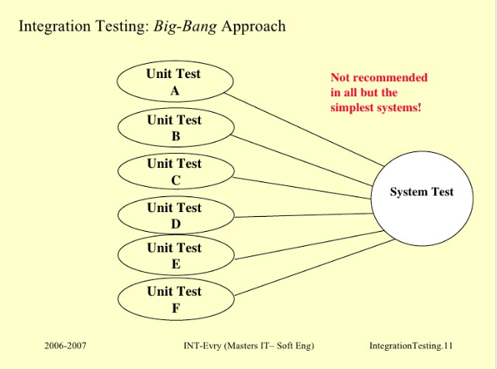

Slide 64
Bottom-up Integration Testing
Integrate and test the bottom level modules first.
A disadvantage of bottom-up testing:
  when the system is made up of a large number of small subsystems.
  This extreme case corresponds to the big bang approach.

Slide 65
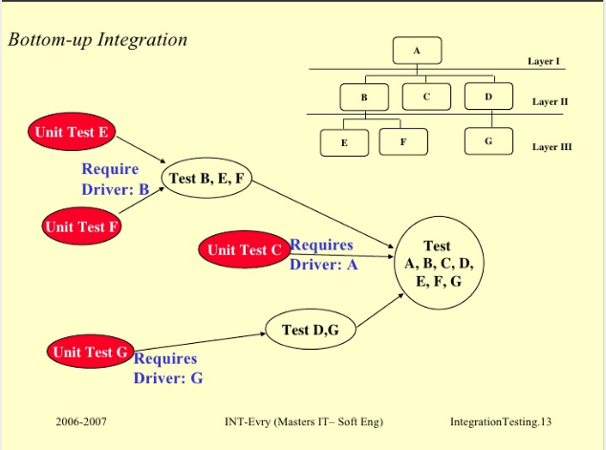

Slide 66
Top-down integration testing
Top-down integration testing starts with the main routine:
  and one or two subordinate routines in the system.
After the top-level 'skeleton’ has been tested:
  immediate subordinate modules of the 'skeleton’ are combined with it and tested.

Slide 67
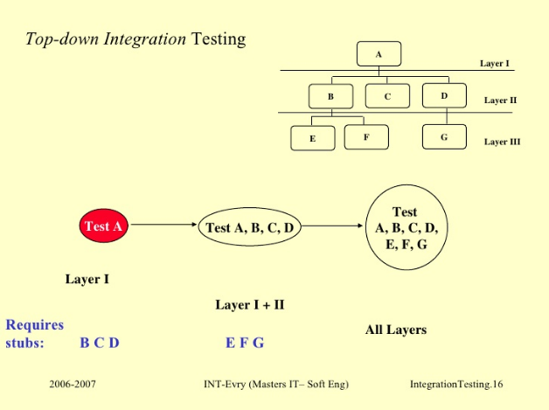

Slide 68
Mixed integration testing
Mixed (or sandwiched) integration testing:
  uses both top-down and bottom-up testing approaches.
  Most common approach

Slide 69
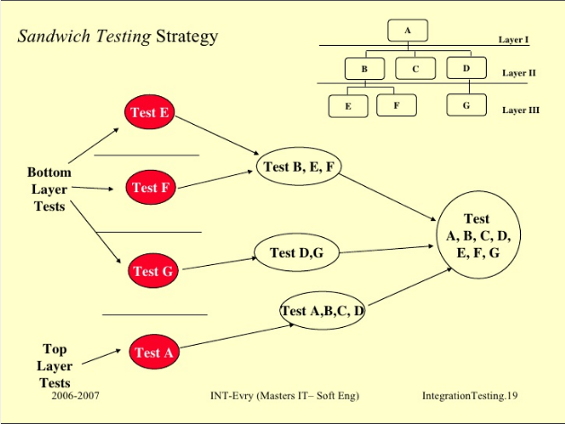
az

Slide 70
Integration Testing
In top-down approach:
  testing waits till all top-level modules are coded and unit tested.
In bottom-up approach:
  testing can start only after bottom level modules are ready.

Slide 71
Phased versus Incremental Integration Testing
Integration can be incremental or phased.
In incremental integration testing,
  only one new module is added to the partial system each time.

Slide 72
Phased versus Incremental Integration Testing
In phased integration,
  a group of related modules are added to the partially integrated system each time.
Big-bang testing:
  a degenerate case of the phased integration testing.

Slide 73
Phased versus Incremental Integration Testing
Phased integration requires less number of integration steps:
  compared to the incremental integration approach.
However, when failures are detected,
  it is easier to debug if using incremental testing
    since errors are very likely to be in the newly integrated module.

Slide 74
System Testing
There are three main kinds of system testing:
  Alpha Testing
  Beta Testing
  Acceptance Testing

Slide 75
Alpha Testing
System testing is carried out by the test team within the developing organization.

Slide 76
Beta Testing
System testing performed by a select group of friendly customers.

Slide 77
Acceptance Testing
System testing performed by the customer himself:
  to determine whether the system should be accepted or rejected.

Slide 78
System Testing
During system testing, in addition to functional tests:
  performance tests are performed.

Slide 79
Performance Testing
Addresses non-functional requirements.
  May sometimes involve testing hardware and software together.
  There are several categories of performance testing.

Slide 80
Stress testing
Evaluates system performance
  when stressed for short periods of time.
Stress testing
  also known as endurance testing.

Slide 81
Stress testing
Stress tests are black box tests:
  designed to impose a range of abnormal and even illegal input conditions
  so as to stress the capabilities of the software.

Slide 82
Stress Testing
If the requirements is to handle a specified number of users, or devices:
  stress testing evaluates system performance when all users or devices are busy simultaneously.

Slide 83
Stress Testing
If an operating system is supposed to support 15 multiprogrammed jobs,
  the system is stressed by attempting to run 15 or more jobs simultaneously.
A real-time system might be tested
  to determine the effect of simultaneous arrival of several high-priority interrupts.

Slide 84
Volume Testing
Addresses handling large amounts of data in the system:
  whether data structures (e.g. queues, stacks, arrays, etc.) are large enough to handle all possible situations
  Fields, records, and files are stressed to check if their size can accommodate all possible data volumes.

Slide 85
Configuration Testing
Analyze system behavior:
  in various hardware and software configurations specified in the requirements
  sometimes systems are built in various configurations for different users
  for instance, a minimal system may serve a single user,
    other configurations for additional users.

Slide 86
Compatibility Testing
These tests are needed when the system interfaces with other systems:
  check whether the interface functions as required.

Slide 87
Compatibility testing
Example
If a system is to communicate with a large database system to retrieve information:
  a compatibility test examines speed and accuracy of retrieval.

Slide 88
Recovery Testing
These tests check response to:
  presence of faults or to the loss of data, power, devices, or services
  subject system to loss of resources
    check if the system recovers properly.

Slide 89
Maintenance Testing
Verify that:
  all required artifacts for maintenance exist
  they function properly

Slide 90
Documentation tests
Check that required documents exist and are consistent:
  user guides,
  maintenance guides,
  technical documents

Slide 91
Documentation tests
Sometimes requirements specify:
  format and audience of specific documents
  documents are evaluated for compliance

Slide 92
Usability tests
All aspects of user interfaces are tested:
  Display screens
  messages
  report formats
  navigation and selection problems

Slide 93
Regression Testing
Does not belong to either unit test, integration test, or system test.
  In stead, it is a separate dimension to these three forms of testing.

Slide 94
Regression testing
Regression testing is the running of test suite:
  after each change to the system or after each bug fix
  ensures that no new bug has been introduced due to the change or the bug fix.

Slide 95
Regression testing
Regression tests assure:
  the new system’s performance is at least as good as the old system
  always used during phased system development.

Slide 96
How many errors are still remaining?
Seed the code with some known errors:
  artificial errors are introduced into the program.
  Check how many of the seeded errors are detected during testing.

Slide 97
Error Seeding
Let:
  N be the total number of errors in the system
  n of these errors be found by testing.
  S be the total number of seeded errors,
  s of the seeded errors be found during testing.

Slide 98
Error Seeding
n/N = s/S
N = S n/s
remaining defects:
N - n = n ((S - s)/ s)

Slide 99
Example
100 errors were introduced.
90 of these errors were found during testing
50 other errors were also found.
Remaining errors=
50 (100-90)/90 = 6

Slide 100
Error Seeding
The kind of seeded errors should match closely with existing errors:
  However, it is difficult to predict the types of errors that exist.
Categories of remaining errors:
  can be estimated by analyzing historical data from similar projects.

Slide 101
Summary
Exhaustive testing of almost any non-trivial system is impractical.
  we need to design an optimal test suite that would expose as many errors as possible.

Slide 102
Summary
If we select test cases randomly:
  many of the test cases may not add to the significance of the test suite.
There are two approaches to testing:
  black-box testing
  white-box testing.

Slide 103
Summary
Black box testing is also known as functional testing.
Designing black box test cases:
  requires understanding only SRS document
  does not require any knowledge about design and code.
Designing white box testing requires knowledge about design and code.

Slide 104
Summary
We discussed black-box test case design strategies:
  equivalence partitioning
  boundary value analysis
We discussed some important issues in integration and system testing.

Slide 105
White-Box Testing
There exist several popular white-box testing methodologies:
  Statement coverage
  branch coverage
  path coverage
  condition coverage
  mutation testing
  data flow-based testing

Slide 106
Statement Coverage
Statement coverage methodology:
  design test cases so that
    every statement in a program is executed at least once.

Slide 107
Statement Coverage
The principal idea:
  unless a statement is executed,
  we have no way of knowing if an error exists in that statement.

Slide 108
Example
int f1(int x, int y){
1 while (x != y){
2 if (x>y) then
3 x=x-y;
4 else y=y-x;
5 }
6 return x; }
Test suit is: (3,3), (4,3) and (3,4) which will do 100% statement coverage
Euclid's GCD Algorithm

Slide 109
Branch Coverage
Test cases are designed such that:
  different branch conditions
    given true and false values in turn.

Slide 110
Branch Coverage
Branch testing guarantees statement coverage:
  a stronger testing compared to the statement coverage-based testing.

Slide 111
Example
int f1(int x,int y){
1 while (x != y){
2 if (x>y) then
3 x=x-y;
4 else y=y-x;
5 }
6 return x; }

Slide 112
Example
Test cases for branch coverage can be:
{(x=3,y=3),(x=3,y=2), (x=4,y=3), (x=3,y=4)}

Slide 113
Condition Coverage
Test cases are designed such that:
  each component of a composite conditional expression
    given both true and false values.

Slide 114
Example
Consider the conditional expression
  ((c1.and.c2).or.c3):
Each of c1, c2, and c3 are exercised at least once,
  i.e. given true and false values.

Slide 115
Branch testing
Condition testing
  stronger testing than branch testing:
Branch testing
  stronger than statement coverage testing.

Slide 116
Condition coverage
Consider a boolean expression having n components:
  for condition coverage we require 2^{n} test cases. (n is no. of condtions)

Slide 117
Path Coverage
Design test cases such that:
  all linearly independent paths in the program are executed at least once.

Slide 118
Linearly independent paths
Defined in terms of
  control flow graph (CFG) of a program.

Slide 119
Path coverage-based testing
To understand the path coverage-based testing:
  we need to learn how to draw control flow graph of a program.

Slide 120
Control flow graph (CFG)
A control flow graph (CFG) describes:
  the sequence in which different instructions of a program get executed.
  the way control flows through the program.

Slide 121
How to draw Control flow graph?
Number all the statements of a program.
Numbered statements:
  represent nodes of the control flow graph.

Slide 122
How to draw Control flow graph?
Sequence:
  1 a=5;
  2 b=a*b-1;
1
2

Slide 123
How to draw Control flow graph?
Selection:
  1 if(a>b) then
  2 c=3;
  3 else c=5;
  4 c=c*c;
1
2
3
4

Slide 124
How to draw Control flow graph?
1
Iteration:
  1 while(a>b){
  2 b=b*a;
  3 b=b-1;}
  4 c=b+d;
2
3
4

Slide 125
Example
int f1(int x,int y){
1 while (x != y){
2 if (x>y) then
3 x=x-y;
4 else y=y-x;
5 }
6 return x; }

Slide 126
Example Control Flow Graph
1
2
3
4
5
6

Slide 127
Path
A path through a program:
  a node and edge sequence from the starting node to a terminal node of the control flow graph.
  There may be several terminal nodes for program.

Slide 128
Independent path
Any path through the program:
  introducing at least one new node:
    that is not included in any other independent paths.

Slide 129
Independent path
It is straight forward:
  to identify linearly independent paths of simple programs.
For complicated programs:
  it is not so easy to determine the number of independent paths.

Slide 130
McCabe's cyclomatic metric
An upper bound:
  for the number of linearly independent paths of a program
Provides a practical way of determining:
  the maximum number of linearly independent paths in a program.

Slide 131
McCabe's cyclomatic metric
Given a control flow graph G,
cyclomatic complexity V(G):
  V(G)= E-N+2
    N is the number of nodes in G
    E is the number of edges in G

Slide 132
Example Control Flow Graph
1
2
3
4
5
6

Slide 133
Example
Cyclomatic complexity =
7-6+2 = 3.

Slide 134
Cyclomatic complexity
Another way of computing cyclomatic complexity:
  inspect control flow graph
  determine number of bounded areas in the graph
V(G) = Total number of bounded areas + 1

Slide 135
Bounded area
Any region enclosed by a nodes and edge sequence.

Slide 136
Example Control Flow Graph
1
2
3
4
5
6

Slide 137
Example
From a visual examination of the CFG:
  the number of bounded areas is 2.
  cyclomatic complexity = 2+1=3.

Slide 138
Cyclomatic complexity
McCabe's metric provides:
    a quantitative measure of testing difficulty and the ultimate reliability
Intuitively,
  number of bounded areas increases with the number of decision nodes and loops.

Slide 139
Cyclomatic complexity
The first method of computing V(G) is amenable to automation:
  you can write a program which determines the number of nodes and edges of a graph
  applies the formula to find V(G).

Slide 140
Cyclomatic complexity
The cyclomatic complexity of a program provides:
  a lower bound on the number of test cases to be designed
  to guarantee coverage of all linearly independent paths.

Slide 141
Cyclomatic complexity
Defines the number of independent paths in a program.
Provides a lower bound:
  for the number of test cases for path coverage.

Slide 142
Cyclomatic complexity
Knowing the number of test cases required:
  does not make it any easier to derive the test cases,
  only gives an indication of the minimum number of test cases required.

Slide 143
Path testing
The tester proposes:
  an initial set of test data using his experience and judgement.

Slide 144
Path testing
A dynamic program analyzer is used:
  to indicate which parts of the program have been tested
  the output of the dynamic analysis
    used to guide the tester in selecting additional test cases.

Slide 145
Derivation of Test Cases
Let us discuss the steps:
  to derive path coverage-based test cases of a program.

Slide 146
Derivation of Test Cases
Draw control flow graph.
Determine V(G).
Determine the set of linearly independent paths.
Prepare test cases:
  to force execution along each path.

Slide 147
Example
int f1(int x,int y){
1 while (x != y){
2 if (x>y) then
3 x=x-y;
4 else y=y-x;
5 }
6 return x; }

Slide 148
Example Control Flow Diagram
1
2
3
4
5
6

Slide 149
Derivation of Test Cases
Number of independent paths: 3
  1,6 test case (x=1, y=1)
  1,2,3,5,1,6 test case(x=1, y=2)
  1,2,4,5,1,6 test case(x=2, y=1)

Slide 150
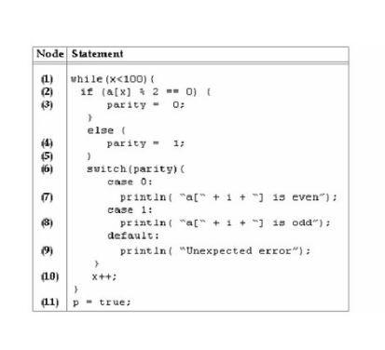

Slide 151
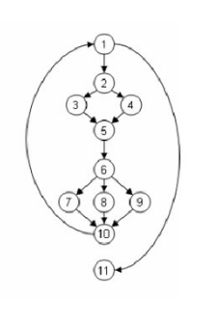

Slide 152
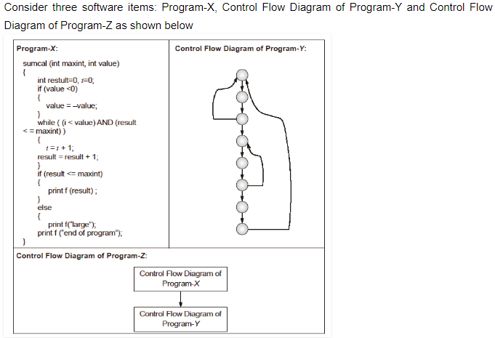

Slide 153
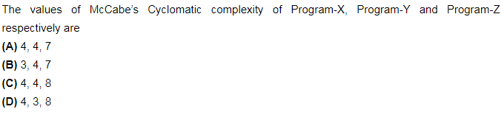



Slide 154
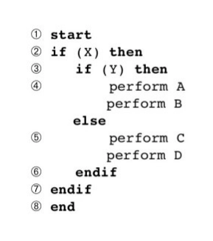
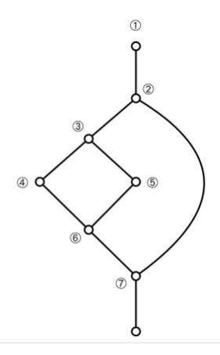

Slide 155
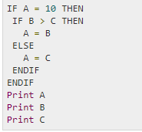

Slide 156
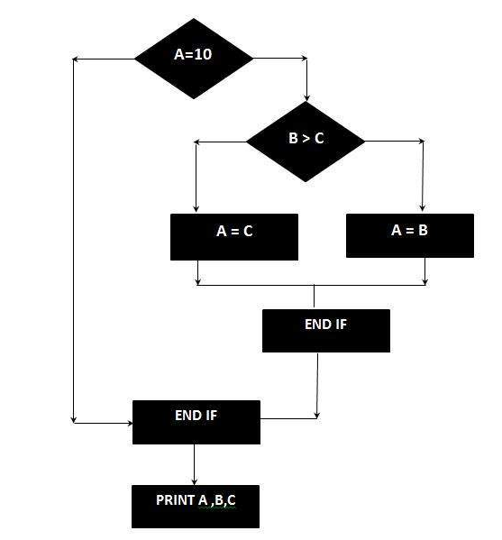

Slide 157
1 int functionY(void)
2 {
3 int x = 0;
4 int y = 19;
5 A: x++;
6 if (x > 999)
7 goto D;
8 if (x % 11 == 0)
9 goto B;
10 else goto A;
11 B: if (x % y == 0)
12 goto C;
13 else goto A;
14 C: printf("%d\n", x);
15 goto A;
16 D: printf("End of list\n");
17 return 0;
18 }

Slide 158
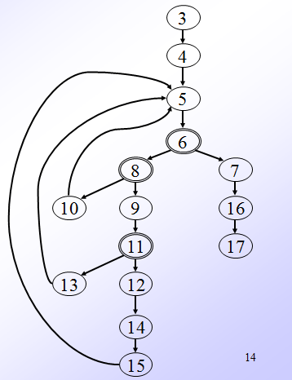

Slide 159
Example 2
1 int functionZ(int y)
2 {
3 int x = 0;
4 while (x <= (y * y))
5 {
6 if ((x % 11 == 0) &&
7 (x % y == 0))
8 {
9 printf(“%d”, x);
10 x++;
11 } // End if
12 else if ((x % 7 == 0) ||
13 (x % y == 1))
14 {
15 printf(“%d”, y);
16 x = x + 2;
} // End else
18 printf(“\n”);
19 } // End while
20 printf("End of list\n");
21 return 0;
22 } // End functionZ

Slide 160
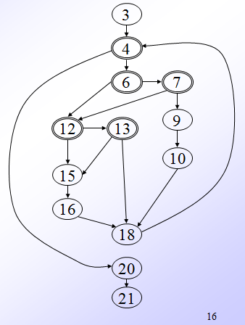

Slide 161
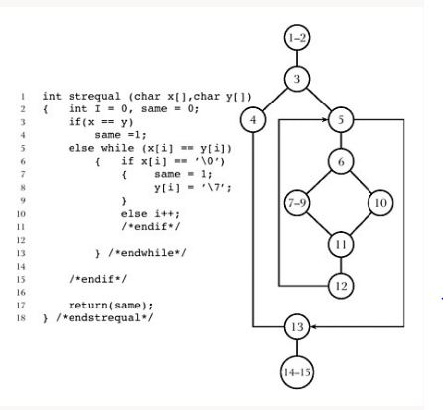

Slide 162
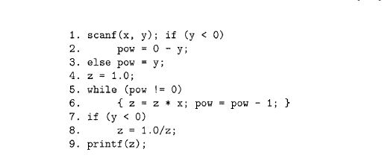

Slide 163
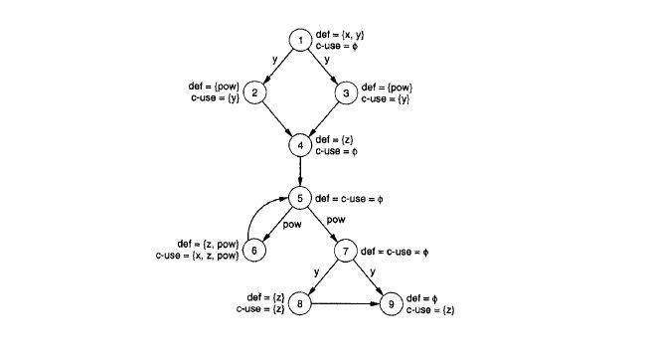

Slide 164
An interesting application of cyclomatic complexity
Relationship exists between:
  McCabe's metric
  the number of errors existing in the code,
  the time required to find and correct the errors.

Slide 165
Cyclomatic complexity
Cyclomatic complexity of a program:
  also indicates the psychological complexity of a program.
  difficulty level of understanding the program.

Slide 166
Cyclomatic complexity
From maintenance perspective,
  limit cyclomatic complexity
    of modules to some reasonable value.
  Good software development organizations:
    restrict cyclomatic complexity of functions to a maximum of ten or so.

Slide 167
Software Reliability
It is truth-worthiness or dependability.
Defined as probability of the product working correctly over a given period of time
It also depends not only number of errors but also on the exact location of errors.
It also depends on execution profile.
It keep changing as errors are detected an fixed

Slide 168
H/W vs S/W Realibilty
H/W component fail due to very different reasons as compared to S/W. These fail due to wear and tear whereas S/W fail due to bugs
Bath-tub curve

Slide 169
Reliability Metrics
Rate of occurrence of failure(ROCOF): frequency of occurrence of failure
Mean time to failure(MTTF)
Mean time to repair(MTTR)
Mean time between failure (MTBF)
Probability of failure on demand (POFOD)
Availability

Slide 170
Types of failure
Transient: only for certain input values while invoking a function
Permanent: for all inputs values while invoking a function
Recoverable: when it occurs, system can recover without having to shutdown the system
Unrecoverable: need to restart the system

Slide 171
Reliability Growth Modelling
Jelinski and Morands Model: simplest model where it is assumed that reliability increases by a constant increment each time an error is detected and repaired
Littlewood and Verall’s Model: assumes that when a repair is carried out, it may introduce additional error. As errors are repaired, the average improvement to realibility per repair decreases

Slide 172
Summary
Designing test cases for black box testing:
  does not require any knowledge of how the functions have been designed and implemented.
  Test cases can be designed by examining only SRS document.

Slide 173
Summary
White box testing:
  requires knowledge about internals of the software.
  Design and code is required.

Slide 174
Summary
We have discussed a few white-box test strategies.
  Statement coverage
  branch coverage
  condition coverage
  path coverage

Slide 175
Summary
A stronger testing strategy:
  provides more number of significant test cases than a weaker one.
  Condition coverage is strongest among strategies we discussed.

Slide 176
Summary
We discussed McCabe’s Cyclomatic complexity metric:
  provides an upper bound for linearly independent paths
  correlates with understanding, testing, and debugging difficulty of a program.

Slide 177
Data Flow-Based Testing
Selects test paths of a program:
  according to the locations of
    definitions and uses of different variables in a program.

Slide 178
Data Flow-Based Testing
For a statement numbered S,
  DEF(S) = {X/statement S contains a definition of X}
  USES(S)= {X/statement S contains a use of X}
  Example: 1: a=b; DEF(1)={a}, USES(1)={b}.
  Example: 2: a=a+b; DEF(1)={a}, USES(1)={a,b}.

Slide 179
Data Flow-Based Testing
A variable X is said to be live at statement S1, if
  X is defined at a statement S:
  there exists a path from S to S1 not containing any definition of X.

Slide 180
DU Chain Example
1 X(){
2 a=5; /* Defines variable a */
3 While(C1) {
4 if (C2)
5 b=a*a; /*Uses variable a */
6 a=a-1; /* Defines variable a */
7 }
8 print(a); } /*Uses variable a */

Slide 181
Definition-use chain (DU chain)
[X,S,S1],
  S and S1 are statement numbers,
  X in DEF(S)
  X in USES(S1), and
  the definition of X in the statement S is live at statement S1.

Slide 182
Data Flow-Based Testing
One simple data flow testing strategy:
  every DU chain in a program be covered at least once.

Slide 183
Data Flow-Based Testing
Data flow testing strategies:
  useful for selecting test paths of a program containing nested if and loop statements

Slide 184
Data Flow-Based Testing
    1 X(){
    2 B1; /* Defines variable a */
    3 While(C1) {
    4 if (C2)
    5 if(C4) B4; /*Uses variable a */
    6 else B5;
    7 else if (C3) B2;
    8 else B3; }
    9 B6 }

Slide 185
Data Flow-Based Testing
[a,1,5]: a DU chain.
Assume:
  DEF(X) = {B1, B2, B3, B4, B5}
  USED(X) = {B2, B3, B4, B5, B6}
  There are 25 DU chains.
However only 5 paths are needed to cover these chains.

Slide 186
Mutation Testing
The software is first tested:
  using an initial testing method based on white-box strategies we already discussed.
After the initial testing is complete,
  mutation testing is taken up.
The idea behind mutation testing:
  make a few arbitrary small changes to a program at a time.

Slide 187
Mutation Testing
Each time the program is changed,
  it is called a mutated program
  the change is called a mutant.

Slide 188
Mutation Testing
A mutated program:
  tested against the full test suite of the program.
If there exists at least one test case in the test suite for which:
  a mutant gives an incorrect result,
  then the mutant is said to be dead.

Slide 189
Mutation Testing
If a mutant remains alive:
  even after all test cases have been exhausted,
  the test suite is enhanced to kill the mutant.
The process of generation and killing of mutants:
  can be automated by predefining a set of primitive changes that can be applied to the program.

Slide 190
Mutation Testing
The primitive changes can be:
  altering an arithmetic operator,
  changing the value of a constant,
  changing a data type, etc.

Slide 191
Mutation Testing
A major disadvantage of mutation testing:
  computationally very expensive,
  a large number of possible mutants can be generated.

Slide 192
Cause and Effect Graphs
Testing would be a lot easier:
  if we could automatically generate test cases from requirements.
Work done at IBM:
  Can requirements specifications be systematically used to design functional test cases?

Slide 193
Cause and Effect Graphs
Examine the requirements:
  restate them as logical relation between inputs and outputs.
  The result is a Boolean graph representing the relationships
    called a cause-effect graph.

Slide 194
Cause and Effect Graphs
Convert the graph to a decision table:
  each column of the decision table corresponds to a test case for functional testing.

Slide 195
Steps to create cause-effect graph
Study the functional requirements.
Mark and number all causes and effects.
Numbered causes and effects:
  become nodes of the graph.

Slide 196
Steps to create cause-effect graph
Draw causes on the LHS
Draw effects on the RHS
Draw logical relationship between causes and effects
  as edges in the graph.
Extra nodes can be added
  to simplify the graph

Slide 197
Drawing Cause-Effect Graphs
A
B
If A then B
A
B
C
If (A and B)then C

Slide 198
Drawing Cause-Effect Graphs
A
B
C
If (A or B)then C
A
B
C
If (not(A and B))then C

Slide 199
Drawing Cause-Effect Graphs
A
B
C
If (not (A or B))then C
A
B
If (not A) then B

Slide 200
Cause effect graph- Example
A water level monitoring system
  used by an agency involved in flood control.
  Input: level(a,b)
    a is the height of water in dam in meters
    b is the rainfall in the last 24 hours in cms

Slide 201
Cause effect graph- Example
Processing
  The function calculates whether the level is safe, too high, or too low.
Output
  message on screen
    level=safe
    level=high
    invalid syntax

Slide 202
Cause effect graph- Example
We can separate the requirements into 5 clauses:
  first five letters of the command is “level”
  command contains exactly two parameters
    separated by comma and enclosed in parentheses

Slide 203
Cause effect graph- Example
Parameters A and B are real numbers:
  such that the water level is calculated to be low
  or safe.
The parameters A and B are real numbers:
  such that the water level is calculated to be high.

Slide 204
Cause effect graph- Example
  Command is syntactically valid
  Operands are syntactically valid.

Slide 205
Cause effect graph- Example
Three effects
  level = safe
  level = high
  invalid syntax

Slide 206
Cause effect graph- Example
1
10
E3
2
11
3
E1
4
E2
5

Slide 207
Cause effect graph- Decision table
Test 1
Test 2
Test 3
Test 4
Test 5
Cause 1
I
I
I
S
I
Cause 2
I
I
I
X
S
Cause 3
I
S
S
X
X
Cause 4
S
I
S
X
X
Cause 5
S
S
I
X
X
Effect 1
P
P
A
A
A
Effect 2
A
A
P
A
A
Effect 3
A
A
A
P
P

Slide 208
Cause effect graph- Example
Put a row in the decision table for each cause or effect:
  in the example, there are five rows for causes and three for effects.

Slide 209
Cause effect graph- Example
The columns of the decision table correspond to test cases.
Define the columns by examining each effect:
  list each combination of causes that can lead to that effect.

Slide 210
Cause effect graph- Example
We can determine the number of columns of the decision table
  by examining the lines flowing into the effect nodes of the graph.

Slide 211
Cause effect graph- Example
Theoretically we could have generated 25=32 test cases.
  Using cause effect graphing technique reduces that number to 5.

Slide 212
Cause effect graph
Not practical for systems which:
  include timing aspects
  feedback from processes is used for some other processes.

Slide 213
SELENIUM

Slide 214
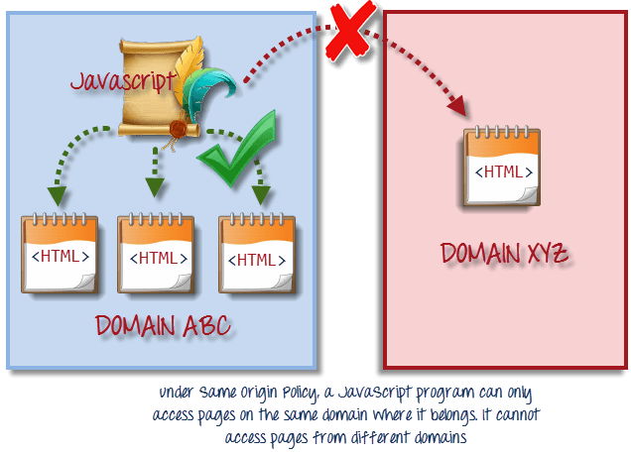
Selenium
Issue with the Selenium core
Same Origin policy prohibits JavaScript code from accessing elements from a domain that is different from where it was launched.

Slide 215
Selenium
Selenium Remote Control
Testers using Selenium Core had to install the whole application under test and the web server on their own local computers because of the restrictions imposed by the same origin policy.
Paul Hammant, decided to create a server that will act as an HTTP proxy to “trick” the browser into believing that Selenium Core and the web application being tested come from the same domain.
his system became known as the Selenium Remote Control or Selenium 1

Slide 216
Selenium
Selenium Grid
Selenium Grid was developed by Patrick Lightbod
To address the need of minimizing test execution times as much as possible.
He initially called the system “Hosted QA.”
It captures the browser screenshots during significant stages,

Slide 217
Selenium is an open-source tool which is used for automating the test cases carried out on web browsers or the web applications that are being tested using any web browser

Slide 218
Selenium Components
Selenium is mainly comprised of 4 components:
Selenium IDE
Selenium RC
Selenium WebDriver
Selenium Grid

Slide 219
Selenium IDE (Integrated Development Environment) is primarily a record and run tool that a test case developer uses to develop Selenium Test cases. Selenium IDE is an easy to use tool from the Selenium Test Suite. It can even be used by someone new to developing automated test cases for their web applications. One does not require any special setup to get started with Selenium IDE. You just need to add the extension of your specific browser. Selenium IDE provides you with a GUI (Graphical User Interface) for easily recording your interactions with the website.

Slide 220
Selenium IDE allows a user or a test case developer to create the Selenium test cases and test suites and edit it later as per their requirements. The development environment also provides the capability of converting test cases to different programming languages, which makes it easier for the user and does not mandate the need for knowing a specific programming language.

Slide 221
Selenium IDE
Selenium Integrated Development Environment is an important part of the Selenium suite. It was first developed as a Firefox plugin, however now it is available in both Firefox and Chrome browser.

Slide 222
Features of Selenium IDE
There are several features provided in the IDE under the toolbar, using which one can control the execution of test cases:
Speed Control – Helps control the speed of test cases
Run All – Allows execution of the entire Test Suite
Run – Runs the currently selected test
Pause/Resume – Allows a user to pause and resume a particular test case
Step – Helps step into each specific command in the test script
Rollup – Helps group all the Selenese Commands together and make them execute as a single operation

Slide 223
Benefits of Using Selenium IDE
Provides you the capability of automatically recording your test cases based upon the interactions with the browser
Gives developers greater flexibility in executing the test cases. Either the test developer can run the entire test suite consisting of multiple test cases or execute a single test case
Operates on the basis of the rich set of Selenese commands, which helps the IDE understand what needs to be done
Allows the test developers to set breakpoints for the purpose of debugging particular test cases
Test cases can be re-used using the run command. (e.g. allowing you to re-use the logic of login or reload on multiple places in the entire suite)

Slide 224
https://www.browserstack.com/automation-testing-tutorial

Slide 225
Question
Which type of testing is done at client end?
Alpha testing
Beta testing
Unit testing
Integrated testing

Slide 226
Question
Which of the following is not part of the Test type?
Functional testing
Statement testing
Unit testing
System testing

Slide 227
Question
A failure is a manifestation of an____
a)Error
b)Fault
c)Both a and b
d)None of above

Slide 228
Question
Which of the following testing is also known as white-box testing?
Structure Testing
Functional testing
Design based testing
None of above

Slide 229
Question
In which type of Integration testing all the modules are integrated at once ?
  big bang approach
  top-down approach
  bottom-up approach
  mixed approach

Slide 230
Question
Which testing is performed by the customer himself?
  Alpha Testing
  Beta Testing
  Acceptance Testing
  None of above

